Slide 1

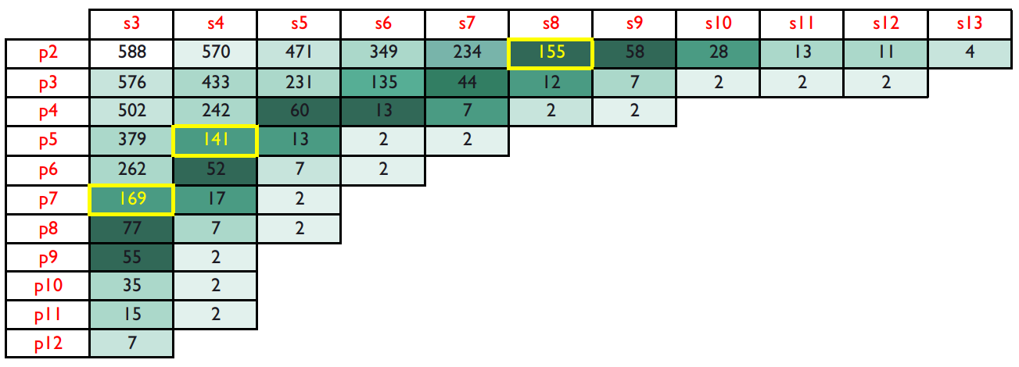
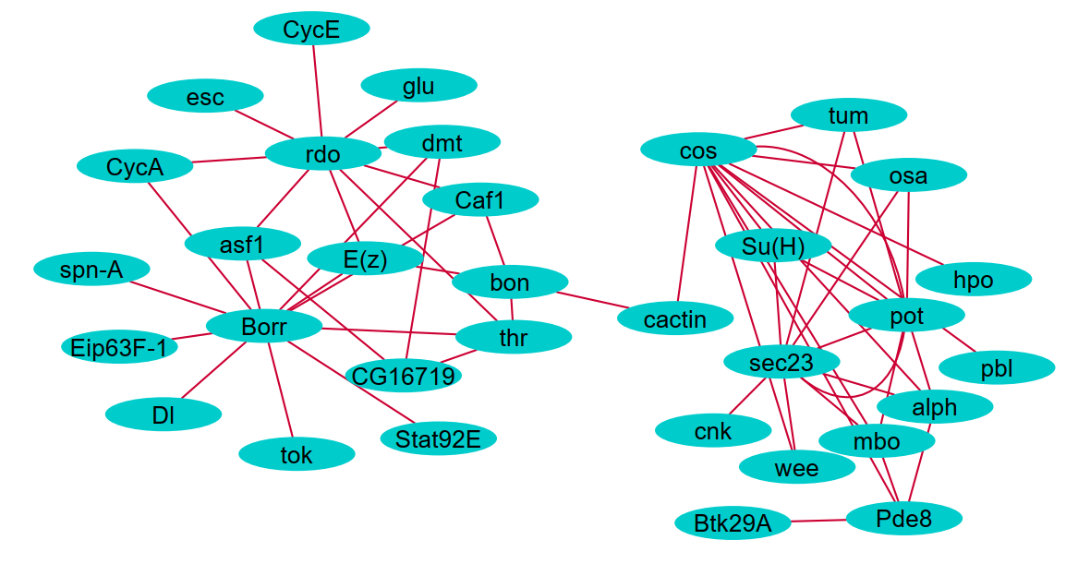

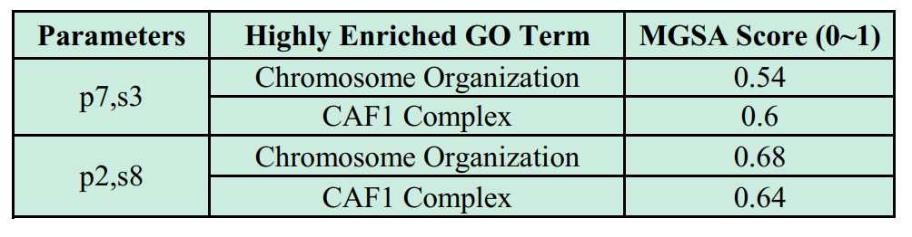
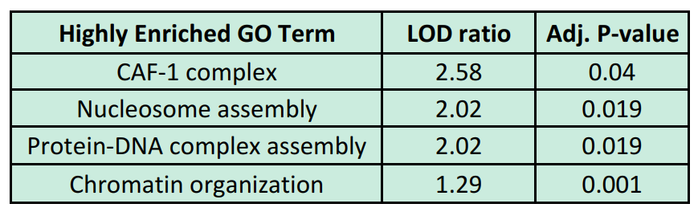
Mining Periodic Subgraphs in Drosophila Developmental Networks
Mohammad Shafiqul Islam and Mohammad Rafsun Jany
Dr. Ahsanur Rahman (Supervisor)
Department of Electrical and Computer Engineering
North South University
mdshafiqul.islam@northsouth.edu, jany.mahin@northsouth.edu, ahsanur.rahman@northsouth.edu
Periodic Subgraph Embedding (PSE) Illustration
Choice of Parameters
Largest Component of a PSE (p = 2, s = 8)
t = 1
t = 2
t = 3
t = 4
t = 5
b
c
b
c
b
c
a
a
a
a
d
e
d
d
e
d
e
A PSE with period p and support s is a subgraph which occurs in at least s graphs that are separated by p timepoints.
Here {(a,d), (d,e)} is a PSE with period 2 and support 3.
{(a,d)} is another PSE with period 1 and support 3.
p: Period
s: Support
Cell: No. of Genes in PSE
Parameters are chosen in such a way that period, support, no. of genes – none is too low.
Dataset
Results of Functional Enrichment Analysis
Future Work
66 temporal networks [2] inferred from the expressions of 588 genes involved in the development of Drosophila.
An edge between two genes in a network indicates that these genes are probably co-regulated at that time.
MGSA [3] enrichment of the largest component in each PSE
Mining PSEs in non-developmental networks and interpret those results.
Redefine PSE in such a that fewer parameters are needed from the user.
Method
References
Choose suitable period (p) and support (s) cut-offs.
Compute PSEs with ListMiner tool [1] using those cut-offs as parameters.
Find the largest connected component in those PSEs.
Compute functional enrichment of genes covered by this component using MGSA algorithm [3].
Sort the nodes (genes) in that component by their degrees and compute the enrichment of this sorted list [4].
FuncAssociate [4] enrichment of sorted (by degrees) list of nodes in the largest component in each PSE
A. Apostolico, M. Barbares, C. Pizzi, Speedup for a periodic subgraph miner, Information Processing Letters, Volume 111, Issue 11, 2011, pp. 521-523.
L. Song, M. Kolar, E. P. Xing; KELLER: estimating time-varying interactions between genes, Bioinformatics, Volume 25, Issue 12, 2009, pp. i128–i136.
S. Bauer, P. N. Robinson, J. Gagneur, Model-based gene set analysis for Bioconductor, Bioinformatics, volume 27, Issue 13, 2011, pp. 1882-1883.
G. F. Berriz, J. E. Beaver, C. Cenik, M. Tasan, F. P. Roth, Next generation software for functional trend analysis, Bioinformatics, Volume 25, Issue 22, 2009, pp. 3043-3044.
Both PSEs gave the same enrichment in the analysis of sorted lists.

